Slide 1
Process Management

Slide 2
Processes
Process Concept
Process Scheduling
Operations on Processes
Interprocess Communication

Slide 3
Objectives
To introduce the notion of a process -- a program in execution, which forms the basis of all computation
To describe the various features of processes, including scheduling and communication.

Slide 4
Process Concept
An operating system executes a variety of programs:
Batch system – jobs
Time-shared systems – user programs or tasks
Textbook uses the terms job and process almost interchangeably
Process – a program in execution; process execution must progress in sequential fashion
A process includes:
program counter
stack
data section

Slide 5
The Process
Multiple parts
The program code, also called text section
Current activity including program counter, processor registers
Stack containing temporary data
Function parameters, return addresses, local variables
Data section containing global variables
Heap containing memory dynamically allocated during run time
Program is passive entity, process is active
Program becomes process when executable file loaded into memory
Execution of program started via GUI mouse clicks, command line entry of its name, etc
One program can be several processes
Consider multiple users executing the same program

Slide 6
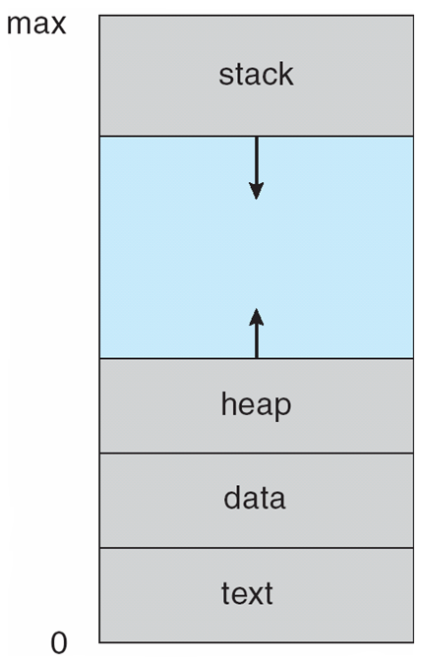
Process in Memory

Slide 7
Process State
As a process executes, it changes state
new: The process is being created
running: Instructions are being executed
waiting: The process is waiting for some event to occur
ready: The process is waiting to be assigned to a processor
terminated: The process has finished execution

Slide 8

Diagram of Process State

Slide 9
Process Control Block (PCB)
Information associated with each process
Process state
Program counter
CPU registers
CPU scheduling information
Memory-management information
Accounting information
I/O status information

Slide 10
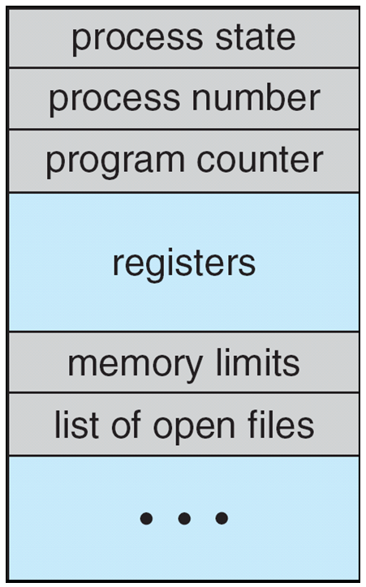
Process Control Block (PCB)

Slide 11

CPU Switch From Process to Process

Slide 12
Process Scheduling
Maximize CPU use, quickly switch processes onto CPU for time sharing
Process scheduler selects among available processes for next execution on CPU
Maintains scheduling queues of processes
Job queue – set of all processes in the system
Ready queue – set of all processes residing in main memory, ready and waiting to execute
Device queues – set of processes waiting for an I/O device
Processes migrate among the various queues

Slide 13
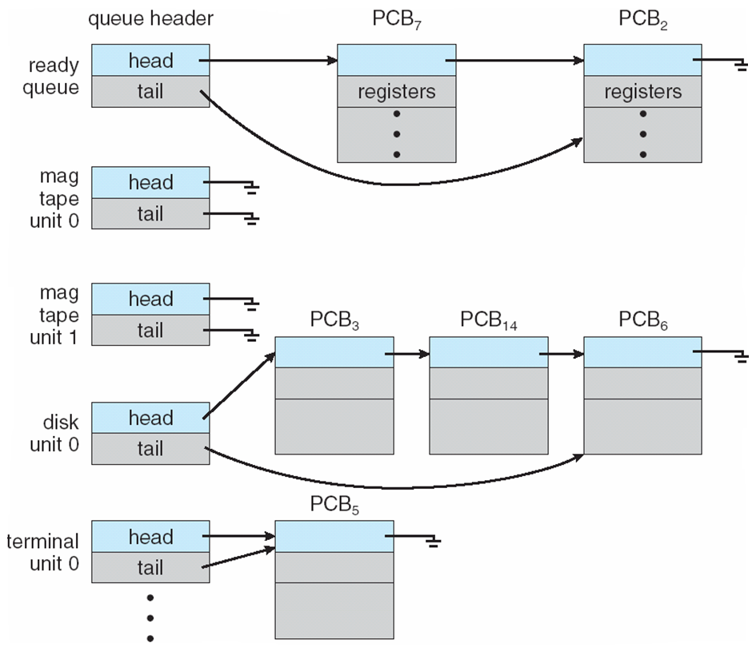
Ready Queue And Various I/O Device Queues

Slide 14
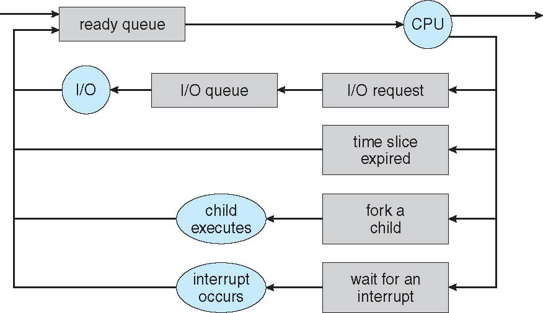
Representation of Process Scheduling

Slide 15
Schedulers
Long-term scheduler (or job scheduler) – selects which processes should be brought into the ready queue
Short-term scheduler (or CPU scheduler) – selects which process should be executed next and allocates CPU
Sometimes the only scheduler in a system

Slide 16
Schedulers (Cont.)
Short-term scheduler is invoked very frequently (milliseconds) ⇒ (must be fast)
Long-term scheduler is invoked very infrequently (seconds, minutes) ⇒ (may be slow)
The long-term scheduler controls the degree of multiprogramming
Processes can be described as either:
I/O-bound process – spends more time doing I/O than computations, many short CPU bursts
CPU-bound process – spends more time doing computations; few very long CPU bursts

Slide 17
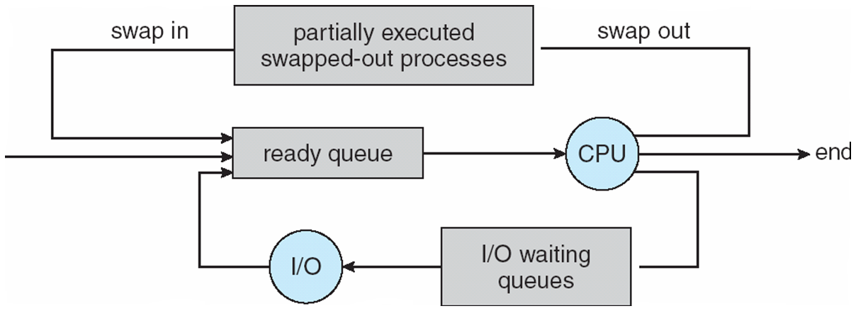
Addition of Medium Term Scheduling

Slide 18
Context Switch
When CPU switches to another process, the system must save the state of the old process and load the saved state for the new process via a context switch.
Context of a process represented in the PCB
Context-switch time is overhead; the system does no useful work while switching
The more complex the OS and the PCB -> longer the context switch
Time dependent on hardware support
Some hardware provides multiple sets of registers per CPU -> multiple contexts loaded at once

Slide 19
Interprocess Communication
Processes within a system may be independent or cooperating
Cooperating process can affect or be affected by other processes, including sharing data
Reasons for cooperating processes:
Information sharing
Computation speedup
Modularity
Convenience
Cooperating processes need interprocess communication (IPC)
Two models of IPC
Shared memory
Message passing

Slide 20
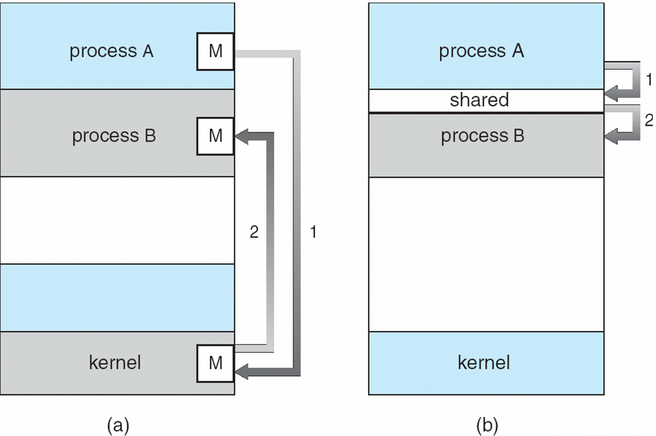
Communications Models

Slide 21
Cooperating Processes
Independent process cannot affect or be affected by the execution of another process
Cooperating process can affect or be affected by the execution of another process
Advantages of process cooperation
Information sharing
Computation speed-up
Modularity
Convenience

Slide 22
Interprocess Communication – Message Passing
Mechanism for processes to communicate and to synchronize their actions
Message system – processes communicate with each other without resorting to shared variables
IPC facility provides two operations:
send(message) – message size fixed or variable
receive(message)
If P and Q wish to communicate, they need to:
establish a communication link between them
exchange messages via send/receive
Implementation of communication link
physical (e.g., shared memory, hardware bus)
logical (e.g., logical properties)

Slide 23
Direct Communication
Processes must name each other explicitly:
send (P, message) – send a message to process P
receive(Q, message) – receive a message from process Q
Properties of communication link
Links are established automatically
A link is associated with exactly one pair of communicating processes
Between each pair there exists exactly one link
The link may be unidirectional, but is usually bi-directional

Slide 24
Indirect Communication
Messages are directed and received from mailboxes (also referred to as ports)
Each mailbox has a unique id
Processes can communicate only if they share a mailbox
Properties of communication link
Link established only if processes share a common mailbox
A link may be associated with many processes
Each pair of processes may share several communication links
Link may be unidirectional or bi-directional

Slide 25
Indirect Communication
Operations
create a new mailbox
send and receive messages through mailbox
destroy a mailbox
Primitives are defined as:
send(A, message) – send a message to mailbox A
receive(A, message) – receive a message from mailbox A

Slide 26
Indirect Communication
Mailbox sharing
P₁, P₂, and P₃ share mailbox A
P₁, sends; P₂ and P₃ receive
Who gets the message?
Solutions
Allow a link to be associated with at most two processes
Allow only one process at a time to execute a receive operation
Allow the system to select arbitrarily the receiver. Sender is notified who the receiver was.

Slide 27
Synchronization
Message passing may be either blocking or non-blocking
Blocking is considered synchronous
Blocking send has the sender block until the message is received
Blocking receive has the receiver block until a message is available
Non-blocking is considered asynchronous
Non-blocking send has the sender send the message and continue
Non-blocking receive has the receiver receive a valid message or null

Slide 28
THANK YOU

